Slide 1
Chapter 2
E-commerce Business Models

Slide 2
Table of contents
Key word definitions
Key Elements of a Business Model
Raising capital
B2C Business Model
B2B Business Model
E-commerce Enablers
Copyright © 2014 Pearson Education, Inc. Publishing as Prentice Hall
Slide 2-<number>

Slide 3
Table of contents
Key word definitions
Key Elements of a Business Model
Raising capital
B2C Business Model
B2B Business Model
E-commerce Enablers
Copyright © 2014 Pearson Education, Inc. Publishing as Prentice Hall
Slide 2-<number>

Slide 4
Key word definitions
Business model
  Set of planned activities designed to result in a profit in a marketplace
  Examples http://articles.bplans.co.uk/starting-a-business/examples-of-well-known-business-models/1040
Business plan
  Describes a firm’s business model
    Examples; http://articles.bplans.com/a-standard-business-plan-outline/
E-commerce business model
  Uses/leverages unique qualities of Internet and Web http://www.tutorialspoint.com/e_commerce/e_commerce_business_models.htm
Slide 2-<number>

Slide 5
Table of contents
Key word definitions
Key Elements of a Business Model
Raising capital
B2C Business Model
B2B Business Model
E-commerce Enablers
Copyright © 2014 Pearson Education, Inc. Publishing as Prentice Hall
Slide 2-<number>

Slide 6
Table of contents
Key word definitions
Key Elements of a Business Model
Raising capital
B2C Business Model
B2B Business Model
E-commerce Enablers
Copyright © 2014 Pearson Education, Inc. Publishing as Prentice Hall
Slide 2-<number>

Slide 7
Eight Key Elements of a Business Model
Value proposition
Revenue model
Market opportunity
Competitive environment
Competitive advantage
Market strategy
Organizational development
Management team
Copyright © 2014 Pearson Education, Inc. Publishing as Prentice Hall
Slide 2-<number>

Slide 8
Key Elements of a Business Model
Value Proposition
How does the product or service fulfill customer needs
Copyright © 2014 PearsonEducation, Inc. Publishing as Prentice Hall
Slide 2-<number>

Slide 9
Key Elements of a Business Model
Value Proposition
Examples:
  Personalization/customization
  Convenience
  Price/No shipping cost
  Quick delivery
  Unparalleled Selection
  Product/service quality
Copyright © 2014 PearsonEducation, Inc. Publishing as Prentice Hall
Slide 2-<number>

Slide 10
Key Elements of a Business Model
Revenue Model
How will the company
earn money
Copyright © 2014 PearsonEducation, Inc. Publishing as Prentice Hall
Slide 2-<number>

Slide 11
Key Elements of a Business Model
Revenue Model
Major types of revenue models:
  Advertising revenue model- Facebook
  Subscription revenue model –Consumer Reports
  Transaction fee revenue model- ebay
  Sales revenue model – AmazonMP3
  Affiliate revenue model – airlines/car rentals/hotels
Copyright © 2014 PearsonEducation, Inc. Publishing as Prentice Hall
Slide 2-<number>

Slide 12
Key Elements of a Business Model
Market Opportunity
The intended Marketspace
of the company and the
potential financial opportunity in that marketspace
Copyright © 2014 PearsonEducation, Inc. Publishing as Prentice Hall
Slide 2-<number>

Slide 13
Key Elements of a Business Model
Competitive Environment
Who else occupies your intended marketspace?
  Other companies selling similar products in the same marketspace
  Includes both direct and indirect competitors
Copyright © 2014 PearsonEducation, Inc. Publishing as Prentice Hall
Slide 2-<number>

Slide 14
Key Elements of a Business Model
Competitive Environment
Influenced by:
  Number and size of active competitors
  Each competitor’s market share
  Competitors’ profitability
  Competitors’ pricing
Copyright © 2014 PearsonEducation, Inc. Publishing as Prentice Hall
Slide 2-<number>

Slide 15
Key Elements of a Business Model
Competitive Advantage
The special advantages of a firm
Copyright © 2014 PearsonEducation, Inc. Publishing as Prentice Hall
Slide 2-<number>

Slide 16
Key Elements of a Business Model
Market Strategy
How do you plan to promote your products or services to attract the target audience
Copyright © 2014 PearsonEducation, Inc. Publishing as Prentice Hall
Slide 2-<number>

Slide 17
Key Elements of a Business Model
Organizational Development
The types of organizational structures within the firm necessary to carry out the business plan
Copyright © 2014 PearsonEducation, Inc. Publishing as Prentice Hall
Slide 2-<number>

Slide 18
Key Elements of a Business Model
Organizational Development
Describes how firm will organize work
  Typically, divided into functional departments
  As company grows, hiring moves from generalists to specialists
Copyright © 2014 PearsonEducation, Inc. Publishing as Prentice Hall
Slide 2-<number>

Slide 19
Key Elements of a Business Model
Management Team
Employees of the company responsible for making the business model work
Copyright © 2014 PearsonEducation, Inc. Publishing as Prentice Hall
Slide 2-<number>

Slide 20
Key Elements of a Business Model
Management Team
“What kind of backgrounds should the company’s leaders have?”
A strong management team:
  Can make the business model work
  Can give credibility to outside investors
  Has market-specific knowledge
  Has experience in implementing business plans
Copyright © 2014 PearsonEducation, Inc. Publishing as Prentice Hall
Slide 2-<number>

Slide 21
Table of contents
Key word definitions
Key Elements of a Business Model
Raising capital
B2C Business Model
B2B Business Model
E-commerce Enablers
Copyright © 2014 Pearson Education, Inc. Publishing as Prentice Hall
Slide 2-<number>

Slide 22
Table of contents
Key word definitions
Key Elements of a Business Model
Raising capital
B2C Business Model
B2B Business Model
E-commerce Enablers
Copyright © 2014 Pearson Education, Inc. Publishing as Prentice Hall
Slide 2-<number>

Slide 23
Raising Capital
Seed capital personal funds used to start business
  Savings
  Credit card advantages
  Home equity loans
  Family
  Friends
Copyright © 2014 Pearson Education, Inc. Publishing as Prentice Hall
Slide 2-<number>

Slide 24
Raising Capital
Traditional sources
  Incubators provide small amount of funding and provide services to start-ups
  Commercial banks
  Angel investors wealthy investors who invest money in exchange for equity share of the business
  Venture capital firms invest funds they manage for other investors
  Strategic partners
Copyright © 2014 Pearson Education, Inc. Publishing as Prentice Hall
Slide 2-<number>

Slide 25
Raising Capital
Crowdfunding
  Using internet to allow individuals to contribute to new ventures
Copyright © 2014 Pearson Education, Inc. Publishing as Prentice Hall
Slide 2-<number>

Slide 26
Crowdfunding Takes Off
What types of projects and companies might be able to most successfully use crowdfunding?
Are there any negative aspects to crowdfunding?
What obstacles are presented in the use of crowdfunding as a method to fund start-ups?
Copyright © 2014 Pearson Education, Inc. Publishing as Prentice Hall
Slide 2-<number>

Slide 27
Table of contents
Key word definitions
Key Elements of a Business Model
Raising capital
B2C Business Model
B2B Business Model
E-commerce Enablers
Copyright © 2014 Pearson Education, Inc. Publishing as Prentice Hall
Slide 2-<number>

Slide 28
Table of contents
Key word definitions
Key Elements of a Business Model
Raising capital
B2C Business Model
B2B Business Model
E-commerce Enablers
Copyright © 2014 Pearson Education, Inc. Publishing as Prentice Hall
Slide 2-<number>

Slide 29
Categorizing E-commerce
Business Models
No one correct way
Text categorizes according to:
  E-commerce relationship (e.g., B2B)
  E-commerce technology (e.g., m-commerce)
Similar business models appear in more than one sector
Some companies use multiple business models (e.g., eBay)
Copyright © 2014 Pearson Education, Inc. Publishing as Prentice Hall
Slide 2-<number>

Slide 30
B2C Business Models
E-tailer
Community provider (social network)
Content provider
Portal
Transaction broker
Market creator
Service provider
Copyright © 2014 Pearson Education, Inc. Publishing as Prentice Hall
Slide 2-<number>

Slide 31
B2C Models: E-tailer
Online version of traditional retailer
Revenue model: Sales
Low barriers to entry
Copyright © 2014 Pearson Education, Inc. Publishing as Prentice Hall
Slide 2-<number>

Slide 32
B2C Models: Community Provider
Provide online environment (social network) where people with similar interests can transact, share content, and communicate
  Examples: Facebook, LinkedIn, Twitter, Pinterest
Revenue models:
  Typically hybrid, combining advertising, subscriptions, sales, transaction fees, and so on
Copyright © 2014 Pearson Education, Inc. Publishing as Prentice Hall
Slide 2-<number>

Slide 33
B2C Models: Content Provider
Digital content on the Web:
  News, music, video, text, artwork
Revenue models:
  Subscription; pay per download (micropayment); advertising; affiliate referral
Copyright © 2014 Pearson Education, Inc. Publishing as Prentice Hall
Slide 2-<number>

Slide 34
B2C Business Models: Portal
Search plus an integrated package of content and services
Revenue models:
  Advertising, referral fees, transaction fees, subscriptions
Copyright © 2014 Pearson Education, Inc. Publishing as Prentice Hall
Slide 2-<number>

Slide 35
B2C Models: Transaction Broker
Process online transactions for consumers
  Primary value proposition—saving time and money
Revenue model:
  Transaction fees
Industries using this model:
  Financial services
  Travel services
  Job placement services
Copyright © 2014 Pearson Education, Inc. Publishing as Prentice Hall
Slide 2-<number>

Slide 36
B2C Models: Market Creator
Create digital environments where buyers and sellers can meet and transact business
Examples:
  Priceline
  eBay
  etrade
Revenue model:
  Transaction fees, fees to merchants for access
Copyright © 2014 Pearson Education, Inc. Publishing as Prentice Hall
Slide 2-<number>

Slide 37
B2C Models: Service Provider
Online services
  Example: Google—Google Maps, Gmail, and so on
Value proposition
  Valuable, convenient, time-saving, low-cost alternatives to traditional service providers
Revenue models:
  Sales of services, subscription fees, advertising, sales of marketing data
Copyright © 2014 Pearson Education, Inc. Publishing as Prentice Hall
Slide 2-<number>

Slide 38
Table of contents
Key word definitions
Key Elements of a Business Model
Raising capital
B2C Business Model
B2B Business Model
E-commerce Enablers
Copyright © 2014 Pearson Education, Inc. Publishing as Prentice Hall
Slide 2-<number>

Slide 39
Table of contents
Key word definitions
Key Elements of a Business Model
Raising capital
B2C Business Model
B2B Business Model
E-commerce Enablers
Copyright © 2014 Pearson Education, Inc. Publishing as Prentice Hall
Slide 2-<number>

Slide 40
B2B Business Models
Net marketplaces
  E-distributor
  E-procurement
  Exchange
  Industry consortium
Private industrial network
Copyright © 2014 Pearson Education, Inc. Publishing as Prentice Hall
Slide 2-<number>

Slide 41
B2B Models: E-distributor
Version of retail and wholesale store, MRO (explain next slide) goods, and indirect goods
Owned by one company seeking to serve many customers
Revenue model: Sales of goods
Example: Grainger.com
Copyright © 2014 Pearson Education, Inc. Publishing as Prentice Hall
Slide 2-<number>

Slide 42
MRO
MRO - Maintenance, repair and operations
Supplies consumed in the production process but which do not either become part of the end product or are not central to the firm's output. MRO items include consumables (such as cleaning, laboratory, or office supplies), industrial equipment (such as compressors, pumps, valves) and plant upkeep supplies (such as gaskets, lubricants, repair tools), and computers, fixtures, furniture, etc.
Copyright © 2014 Pearson Education, Inc. Publishing as Prentice Hall
Slide 2-<number>

Slide 43
B2B Models: E-procurement
Creates and sells access to digital markets where participants transact for indirect goods
  B2B service providers, application service providers (ASPs)
Revenue model:
  Service fees, supply-chain management, fulfillment services
Example: Ariba- http://www.ariba.com/about/our-story
Copyright © 2014 Pearson Education, Inc. Publishing as Prentice Hall
Slide 2-<number>

Slide 44
B2B Models: Exchanges
Independently owned vertical digital marketplace where hundreds of suppliers meet small number of large commercial purchasers
Revenue model: Transaction, commission fees
Create powerful competition between suppliers
Tend to force suppliers into powerful price competition; number of exchanges has dropped dramatically
Copyright © 2014 Pearson Education, Inc. Publishing as Prentice Hall
Slide 2-<number>

Slide 45
B2B Models: Industry Consortia
Industry-owned vertical digital marketplace open to select suppliers
More successful than exchanges
  Sponsored by powerful industry players
  Strengthen traditional purchasing behavior
Revenue model: Transaction, commission fees
Example: Exostar - http://www.exostar.com/Mission/
Copyright © 2014 Pearson Education, Inc. Publishing as Prentice Hall
Slide 2-<number>

Slide 46
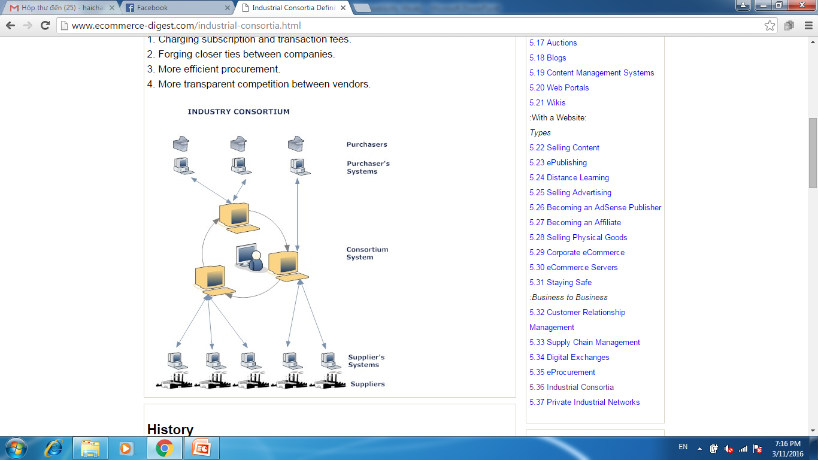
Copyright © 2014 Pearson Education, Inc. Publishing as Prentice Hall
Slide 2-<number>

Slide 47
Private Industrial Networks
Digital network used to coordinate among firms engaged in business together
Typically evolve out of company’s internal enterprise system
Example: Walmart’s network for suppliers
Cost absorbed by network owner and recovered through production and distribution efficiencies
Copyright © 2014 Pearson Education, Inc. Publishing as Prentice Hall
Slide 2-<number>

Slide 48
Table of contents
Key word definitions
Key Elements of a Business Model
Raising capital
B2C Business Model
B2B Business Model
E-commerce Enablers
Copyright © 2014 Pearson Education, Inc. Publishing as Prentice Hall
Slide 2-<number>

Slide 49
Table of contents
Key word definitions
Key Elements of a Business Model
Raising capital
B2C Business Model
B2B Business Model
E-commerce Enablers
Copyright © 2014 Pearson Education, Inc. Publishing as Prentice Hall
Slide 2-<number>

Slide 50
E-commerce Enablers:
The Gold Rush Model
E-commerce infrastructure companies have profited the most:
  Hardware, software, networking, security
  E-commerce software systems, payment systems
  Media solutions, performance enhancement
  CRM software
  Databases
  Hosting services, and so on
Copyright © 2014 Pearson Education, Inc. Publishing as Prentice Hall
Slide 2-<number>

Slide 51
How E-commerce Changes Business
E-commerce changes industry structure by changing:
  Rivalry among existing competitors
  Barriers to entry
  Threat of new substitute products
  Strength of suppliers
  Bargaining power of buyers
Copyright © 2014 Pearson Education, Inc. Publishing as Prentice Hall
Slide 2-<number>

Slide 52
Industry Value Chains
Set of activities performed by suppliers, manufacturers, transporters, distributors, and retailers that transform raw inputs into final products and services
Internet reduces cost of information and other transactional costs
Leads to greater operational efficiencies, lowering cost, prices, adding value for customers
Copyright © 2014 Pearson Education, Inc. Publishing as Prentice Hall
Slide 2-<number>

Slide 53
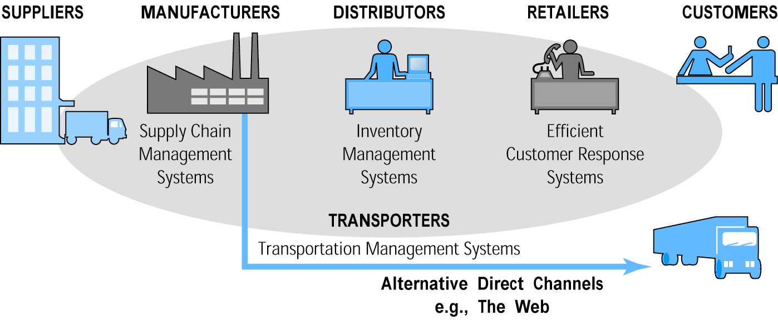
E-commerce and Industry Value Chains
Figure 2.5, Page 90
Copyright © 2014 Pearson Education, Inc. Publishing as Prentice Hall
Slide 2-<number>

Slide 54
Firm Value Chains
Activities that a firm engages in to create final products from raw inputs
Each step adds value
Effect of Internet:
  Increases operational efficiency
  Enables product differentiation
  Enables precise coordination of steps in chain
Copyright © 2014 Pearson Education, Inc. Publishing as Prentice Hall
Slide 2-<number>

Slide 55
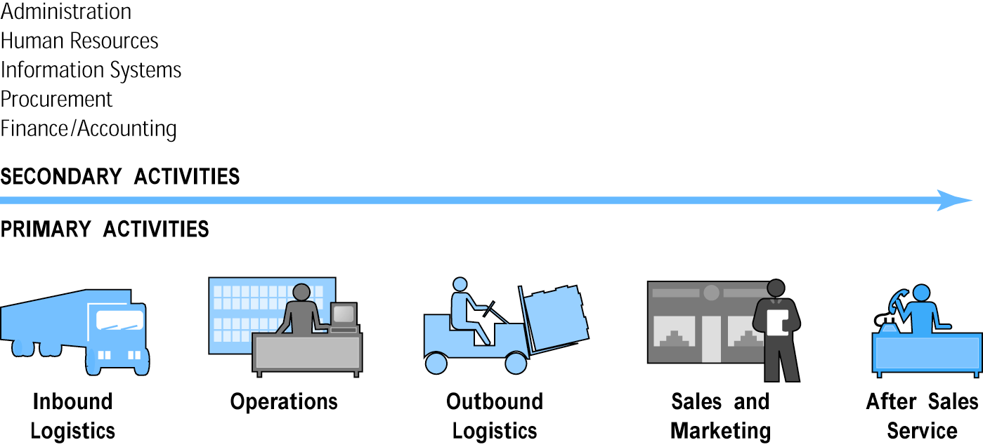
E-commerce and Firm Value Chains
Figure 2.6, Page 91
Copyright © 2014 Pearson Education, Inc. Publishing as Prentice Hall
Slide 2-<number>

